Slide 1


DARS
UPDATES

Slide 2
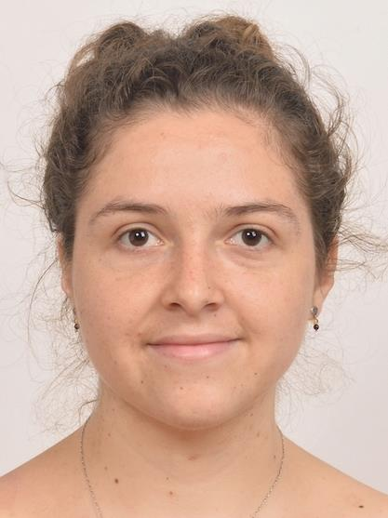
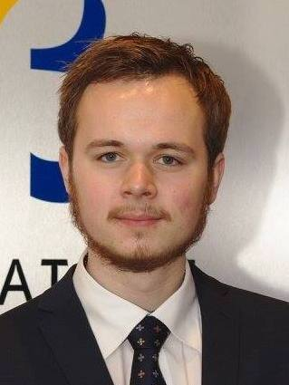

Sofia Vazquez Alferez
sofia.vazquezalferez@maastrichtuniversity.nl
Raphaël Morsomme
raphael.morsomme@maastrichtuniversity.nl

Slide 3

Content
The Project & what we’re doing
Your Ideas and needs
Where we’re at

Slide 4
1. The Project & What we’re doing

Slide 5
The Project
September 2018
Recommender System for Students
MSLAS
Wider Impact
Supporting Team

Slide 6
GOAL
To improve the information position of students with regard to their academic and professional interest, by complementing the work of academic advising and examination committee.

Slide 7
Stakeholders
Management
Curriculum Development
Students
Academic Advisors

Slide 8
2. Your Ideas

Slide 9
3. Where we’re at

Slide 10
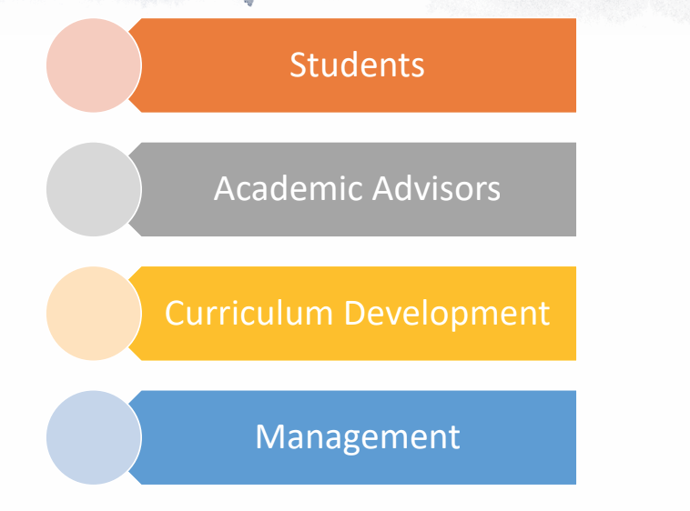
The Recommender System
Stakeholders
The System
Topic Modelling
Sequential Pattern mining

Slide 11
Recommender System for Students
Sequence Mining
Find common sequences of courses with outcomes (e.g. pass/fail, grades)
Topic Modeling
Model the underlying topics of all courses at UCM using LDA
APP:
Asks students for proposed curriculum and gives RedFlags
Identify RedFlags
Identify courses that share topics based on their words
Asks students for key words of interest and gives course recommendations

Slide 12

By Products

Slide 13
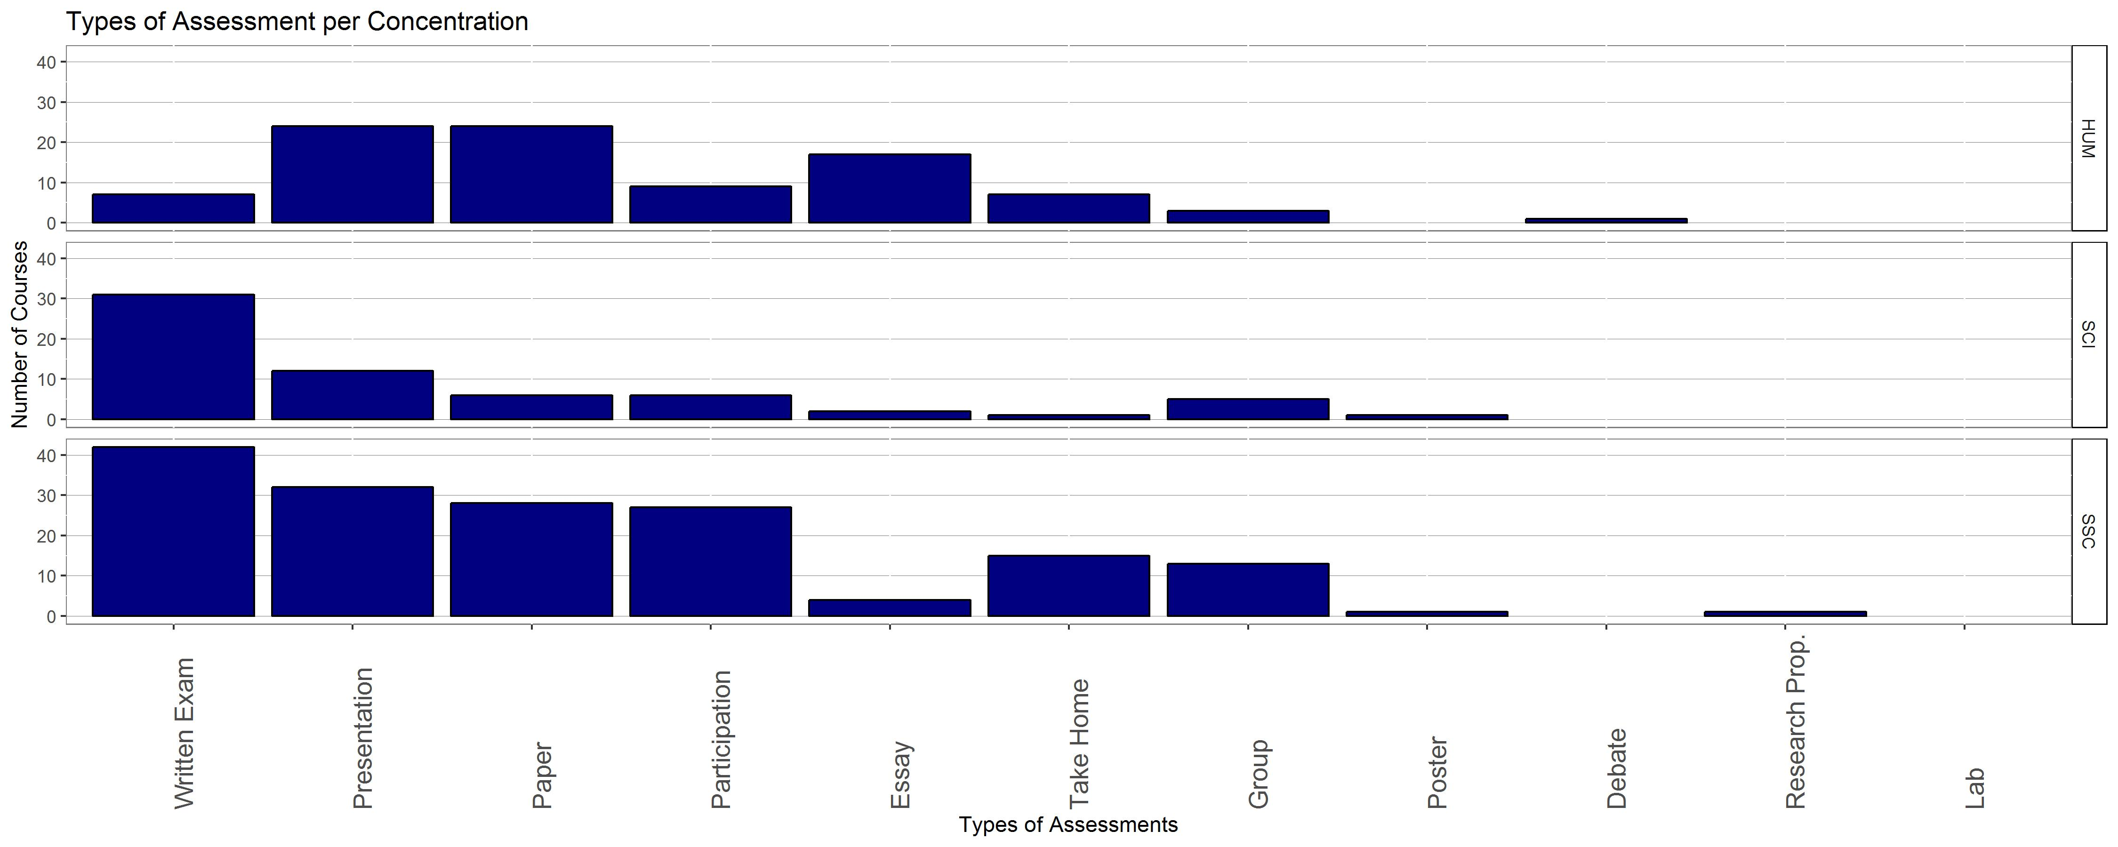
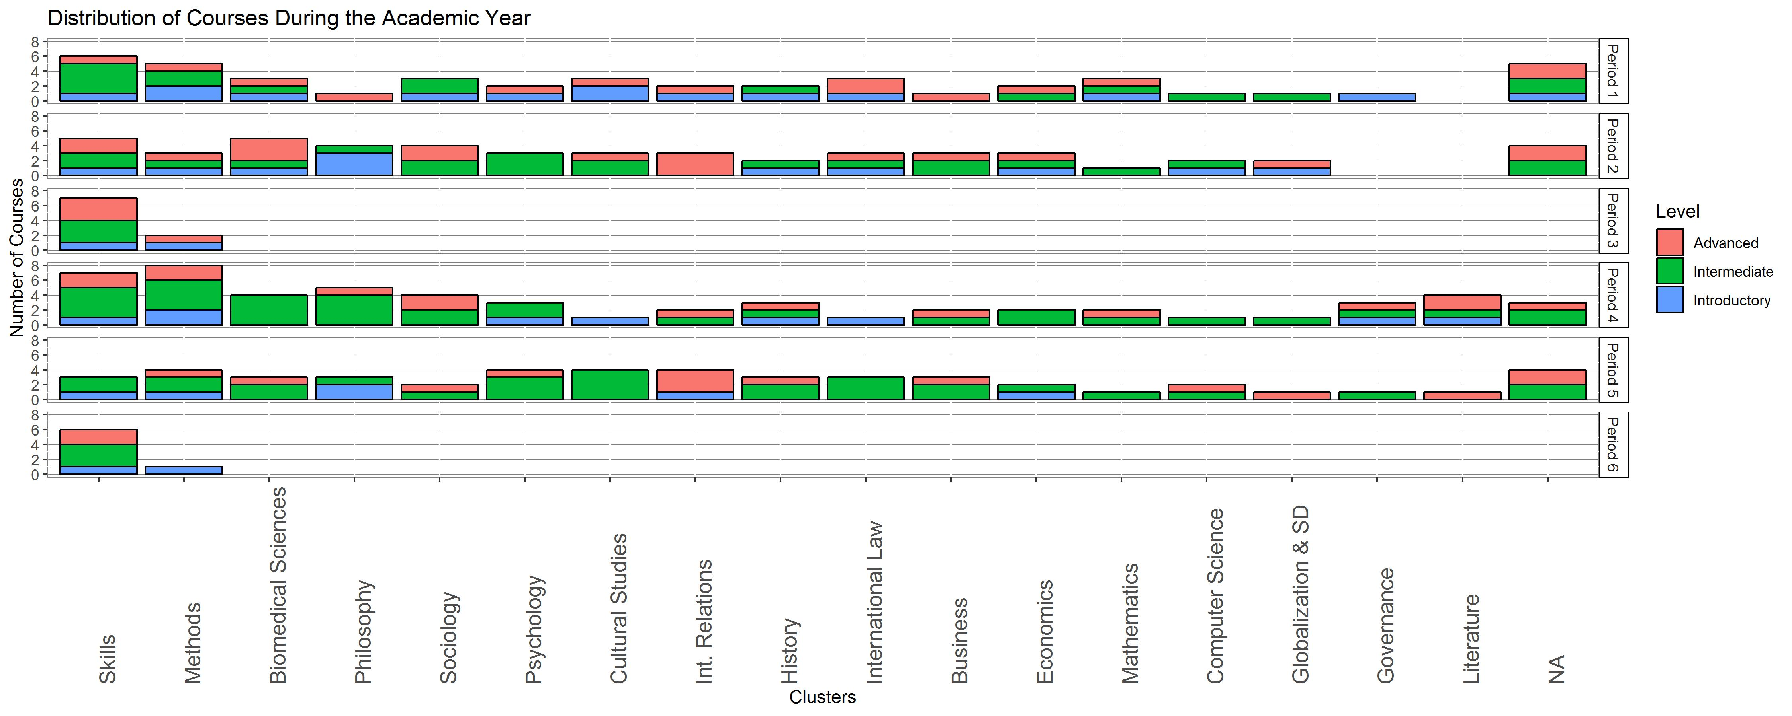

Slide 14
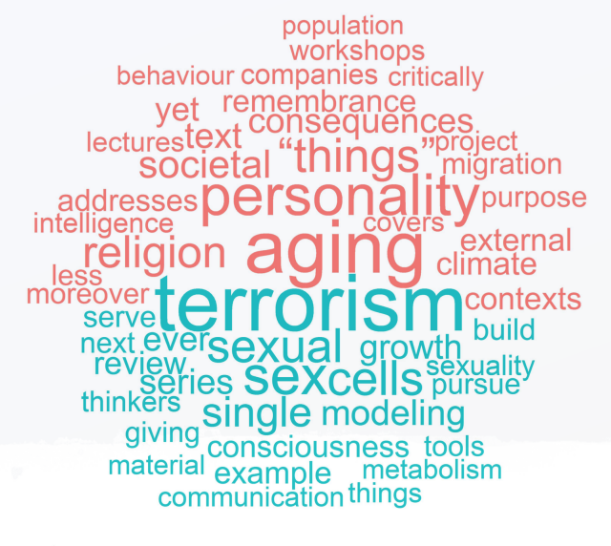
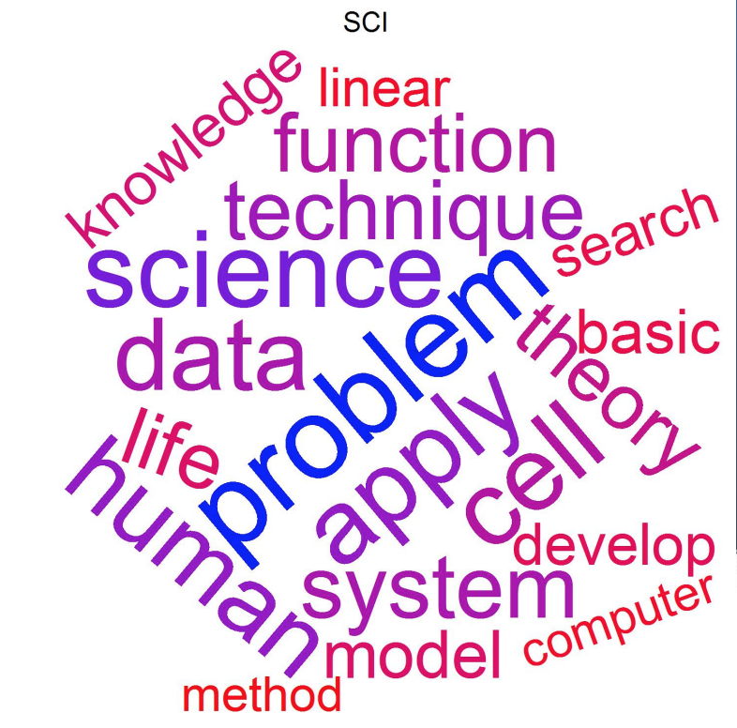

Emerging topics
Per concentration
Per course

Slide 15
Thank you!
Sofia Vazquez Alferez
sofia.vazquezalferez@maastrichtuniversity.nl
Raphaël Morsomme
raphael.morsomme@maastrichtuniversity.nl

